Slide 1


JUSTDRINKS LTD. DATA DUE DILLIGENCE
GROUP 3(DATA COHORT)

Slide 2

Group Members
Temitope Olaitan
Samson Adetoyi
Barakat Oyeniyi
Samuel Eche
Ugonma Ajie
Loveth Akpa
Kimberly Peters
Ayomide Fadeyi
EstherJoan Ikiseh
Abiodun Popoola

Slide 3
About JustDrinks Ltd.
JustDrink has emerged to become one of the largest Retail Stores for alcoholic drinks in the state of Lincoln
We currently have about 80stores
Total Sales above 450million dollars
The current data available is on Vendors, Purchases and Stocks
Hence, there is a need to expand the business’ data resources in order to have deeper insights into other variables such as sales, employee and customers.

Slide 4
Data as the New “Oil”
Data is the lifeblood of modern business operations.
It serves as the foundation for informed decision-making.
Data enables businesses to understand their customers, market trends, and operational performance.
With data, businesses can identify opportunities, mitigate risks, and optimize processes for efficiency and growth.
It empowers organizations to stay competitive in a rapidly evolving market landscape.
Effective data utilization leads to improved customer satisfaction, increased profitability, and sustainable business success.

Slide 5
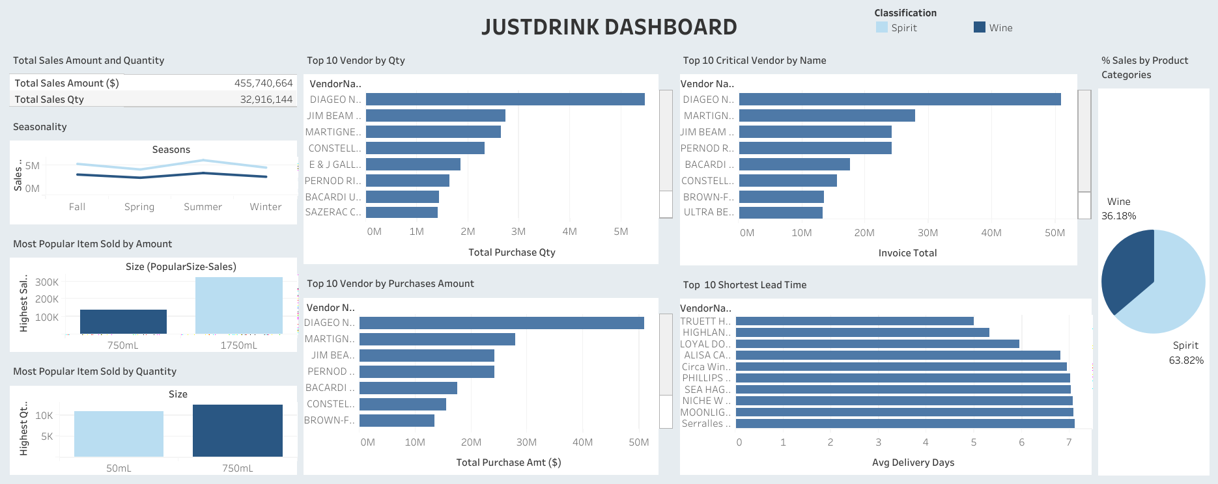
Current Data Insight/Dashboar

Slide 6
Proposed Data/Variables for Collection
Sales Data – daily, weekely and monthly sales figures
Customer Demographics – Age, Gender, Income Level, Drink’s Preference
Market Effectiveness – data on campaign’s performance
Supply Chain Efficiency
Operational Efficiency – employee productivity, inventory turnover and supply chain performance.
Customer Feedback & Reviews

Slide 7
Benefits of Additional Data
Informed Decision Making
Enhanced Customer Experience
Improved Operational Performance
Competitive Advantage

Slide 8
Conclusion
In today's digital age, data helps businesses harness the power of robust and comprehensive data gain a strategic advantage over their competitors.
Therefore, it is important that JustDrinks Ltd harvest data from sales, customer demography and employees in order to gain more insights into the performance of these entities and drive business growth and innovations.

Slide 9

Questions

Slide 10

Thank you

